Slide 1
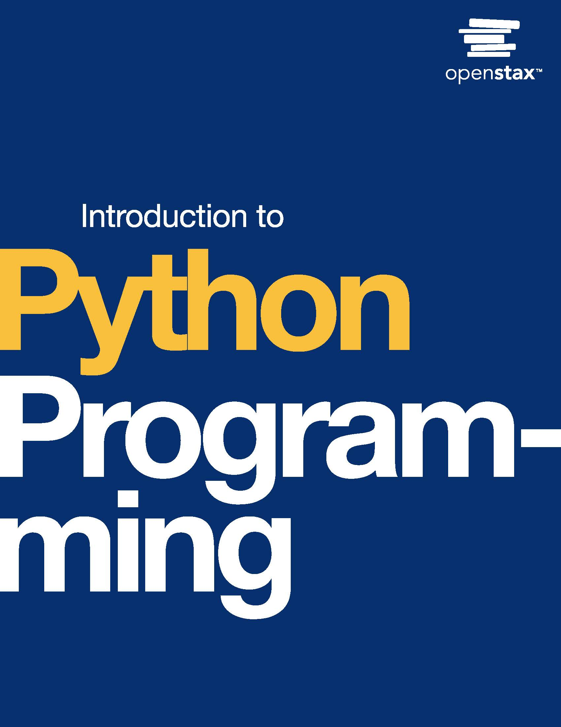
Introduction to Python Programming
Chapter 4: Decisions

Slide 2
Chapter outline
Boolean values
If-else statements
Boolean operations
Operator precedence
Chained decisions
Nested decisions
Conditional expressions

Slide 3

Figure 4.1
credit: modification of work "Fork In The Road", by Ian Sane/Flickr, CC BY 2.0
Notes:
a group of trees with paths on either side

Slide 4
4.1 Boolean values
Learning Objectives
Explain a Boolean value.
Use bool variables to store Boolean values.
Demonstrate converting integers, floats, and strings to Booleans.
Demonstrate converting Booleans to integers, floats, and strings.
Use comparison operators to compare integers, floats, and strings.

Slide 5
4.1 Boolean values
The bool data type, standing for Boolean, represents a binary value of either true or false.
true and false are keywords, and capitalization is required.

Slide 6
4.1 Boolean values
bool() converts a value to a Boolean value, True or False.
True: any non-zero number, any non-empty string
False: 0, empty string
.

Slide 7
4.1 Boolean values
Comparison operators are used to compare values, and the result is either true or false.
The 6 comparison operators:
equal to: ==
not equal to: !=
greater than: >
less than: <
greater than or equal to: >=
less than or equal to: <=

Slide 8
4.2 If-else statements
Learning Objectives
Identify which operations are performed when a program with if and if-else statements is run.
Identify the components of an if and if-else statement and the necessary formatting.
Create an if-else statement to perform an operation when a condition is true and another operation otherwise.

Slide 9
4.2 If-else statements
A condition is an expression that evaluates to true or false.
An if statement is a decision-making structure that contains a condition and a body of statements.
If the condition is true, the body is executed.
If the condition is false, the body is not executed.
The if statement's body must be grouped together and have one level of indentation.
The PEP 8 style guide recommends four spaces per indentation level.
The Python interpreter will produce an error if the body is empty.

Slide 10
4.2 If-else statements
if-else statement
An if statement defines actions to be performed when a condition is true. What if an action needs to be performed only when the condition is false?
Ex: If the restaurant is less than a mile away, we'll walk. Else, we'll drive.
An else statement is used with an if statement and contains a body of statements that is executed when the if statement's condition is false.
When an if-else statement is executed, one and only one of the branches is taken. That is, the body of the if or the body of the else is executed.
Note: The else statement is at the same level of indentation as the if statement, and the body is indented.

Slide 11
4.3 Boolean operations
Learning Objectives
Explain the purpose of logical operators.
Describe the truth tables for and, or, and not.
Create expressions with logical operators.
Interpret if-else statements with conditions using logical operators.

Slide 12
4.3 Boolean operations
Logical operator: and
Decisions are often based on multiple conditions.
Ex: A program printing if a business is open may check that hour >= 9 and hour < 17.
A logical operator takes condition operand(s) and produces True or False.
Python has three logical operators: and, or, and not.
The and operator takes two condition operands and returns True if both conditions are true.

Slide 13
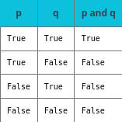
Table 4.1 Truth table: p and q.

Slide 14
4.3 Boolean operations
Logical operator: or
Sometimes a decision only requires one condition to be true.
Ex: If a student is in the band or choir, they will perform in the spring concert.
The or operator takes two condition operands and returns True if either condition is true.

Slide 15
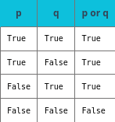
Table 4.2 Truth table: p or q.

Slide 16
4.3 Boolean operations
Logical operator: not
The not operator takes one condition operand and returns True when the operand is false and returns False when the operand is true.
not is a useful operator that can make a condition more readable and can be used to toggle a Boolean's value. Ex: is_on = not is_on.

Slide 17

Table 4.3 Truth table: not p.

Slide 18
4.4 Operator precedence
Learning Objectives
Describe how precedence impacts order of operations.
Describe how associativity impacts order of operations.
Explain the purpose of using parentheses in expressions with multiple operators.

Slide 19
4.4 Operator precedence
Precedence
Precedence rules provide the priority level of operators.
Operators with the highest precedence execute first.
Ex: 1 + 2 * 3 is 7 because multiplication takes precedence over addition.
However, (1 + 2) * 3 is 9 because parentheses take precedence over multiplication.

Slide 20
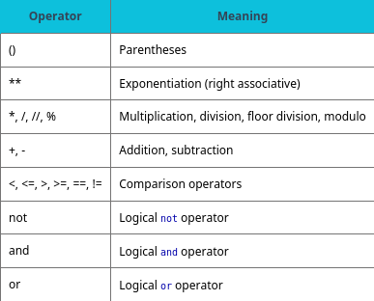
Table 4.4 Operator precedence from highest to lowest.

Slide 21
4.4 Operator precedence
Associativity
Associativity determines the order of operations when precedence is the same.
Ex: 8 / 4 * 3 is evaluated as (8/4) * 3 rather than 8 / (4*3) because multiplication and division are left associative.
Most operators are left associative and are evaluated from left to right.
Exponentiation is right associative: that is, evaluated from right to left. Ex: 2 ** 3 ** 4 is evaluated as 2 ** (3**4).

Slide 22
4.5 Chained decisions
Two separate if statements do not guarantee that only one branch is taken and might result in both branches being taken.
Chaining decision statements with elif allows the programmer to check for multiple conditions.
An elif (short for else if) statement checks a condition when the prior decision statement's condition is false.
An elif statement is part of a chain and must follow an if (or elif) statement.

Slide 23
4.5 Chained decisions
if-elif-else statements
Elifs can be chained with an if-else statement to create a more complex decision statement.
Ex: A program shows possible chess moves depending on the piece type.
If the piece is a pawn, show moving forward one (or two) places.
Else if the piece is a bishop, show diagonal moves.
Else if . . . (finish for the rest of the pieces).

Slide 24
4.6 Nested decisions
Learning Objectives
Describe the execution paths of programs with nested if-else statements.
Implement a program with nested if-else statements.

Slide 25
4.7 Conditional expressions
Learning Objectives
Identify the components of a conditional expression.
Create a conditional expression.

Slide 26
4.7 Conditional expressions
Conditional expressions
A conditional expression (also known as a "ternary operator") is a simplified, single-line version of an if-else statement.
A variable can be assigned with a conditional expression.
Ex: Finding the max of two numbers can be calculated with max_num = y if x < y else x
Note: Conditional expressions have the lowest precedence of all Python operations.

Slide 27
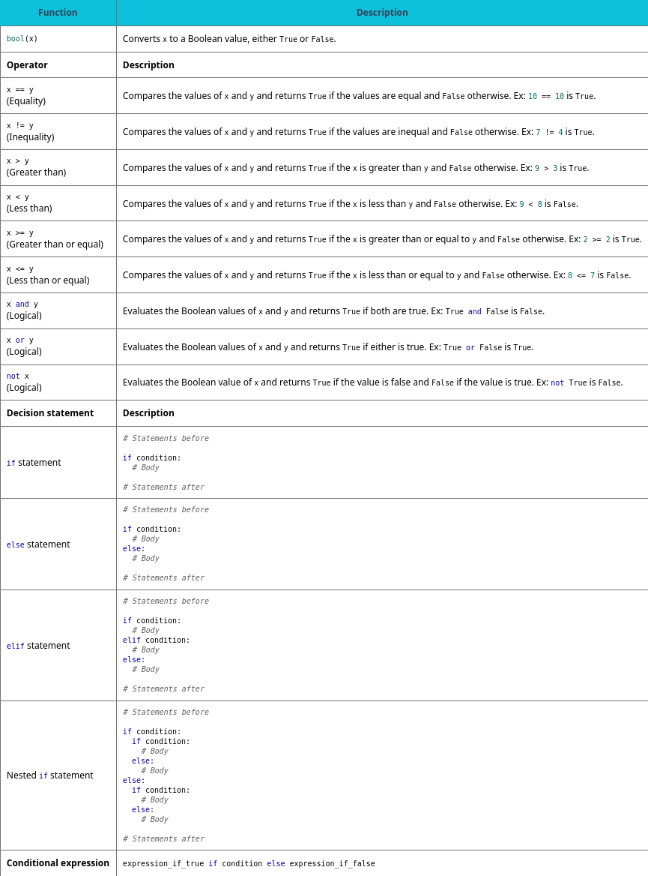
Table 4.5 Chapter 4 reference.

Slide 28
This ancillary resource is licensed under a Creative Commons Attribution-NonCommercial-ShareAlike 4.0 (CC BY NC-SA) license; it may be distributed, remixed, built upon for noncommercial purposes only, and must be attributed to OpenStax and redistributed under the same license.

